Slide 1
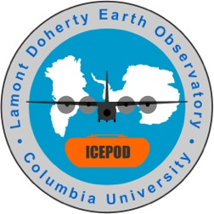
The Many Faces of Antarctica
MODIS Satellite Image (puzzle)
Bed Topography
Ice Velocity
Geography
Ice Mass Loss
Subglacial Lakes
Ice Elevation

Slide 2
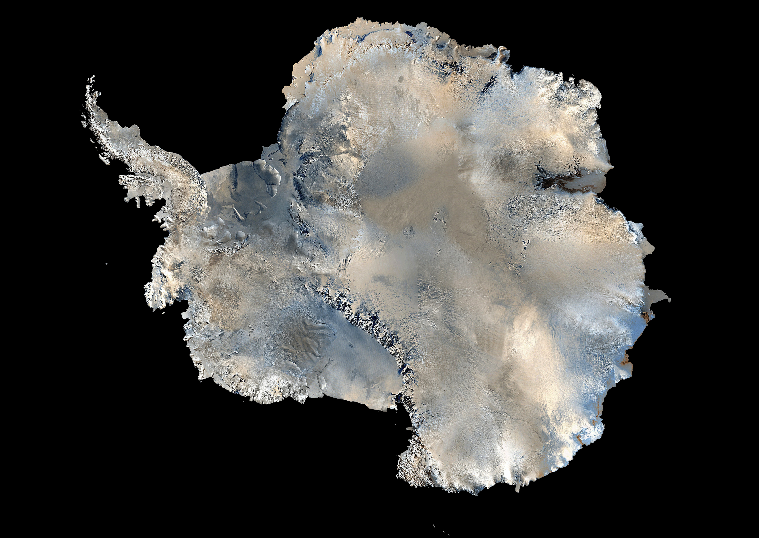
Columbia Climate Center at the Earth Institute * Barnard College * American Museum of Natural History * Arctic Institute of North America * Association of Interior Native Educators * Center for New Media Teaching & Learning * Center for Research on Environmental Decisions * International Arctic Research Center * Lamont-Doherty Earth Observatory * Museum of the North * Teachers College * University of Alaska Fairbanks * University of New Hampshire
Image created by USGS using AVHRR NOAA Satellite data

Slide 3
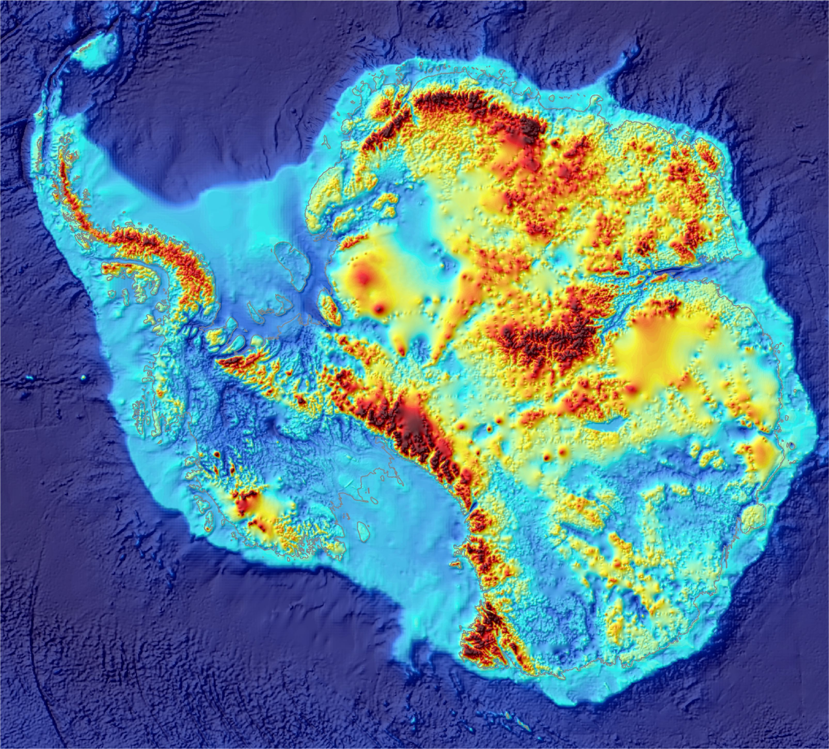
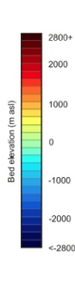
Gamburtsev Mountains
Roosevelt Island
Columbia Climate Center at the Earth Institute * Barnard College * American Museum of Natural History * Arctic Institute of North America * Association of Interior Native Educators * Center for New Media Teaching & Learning * Center for Research on Environmental Decisions * International Arctic Research Center * Lamont-Doherty Earth Observatory * Museum of the North * Teachers College * University of Alaska Fairbanks * University of New Hampshire
Antarctic Bed elevation data from the Bedmap 2 project , 2013

Slide 4
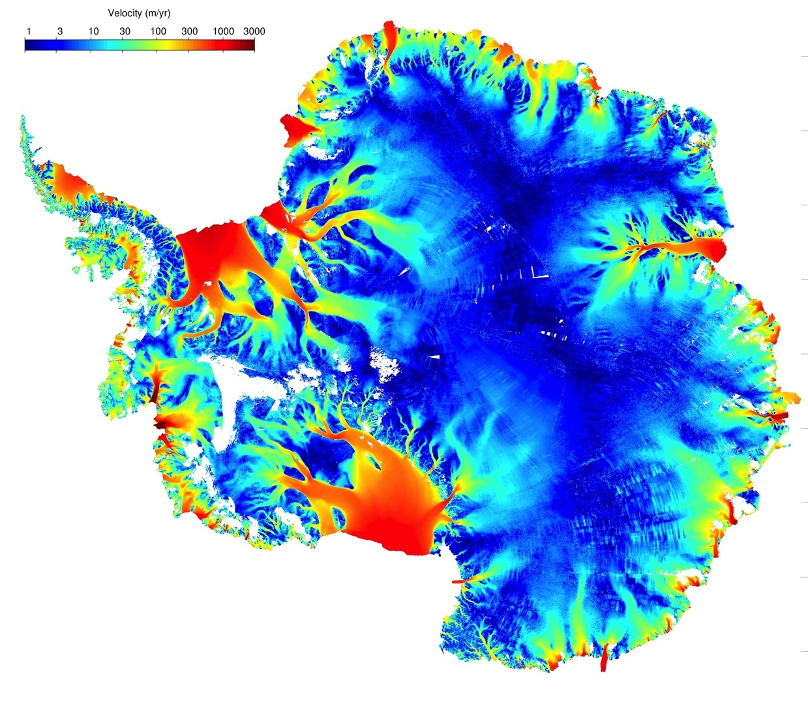
Columbia Climate Center at the Earth Institute * Barnard College * American Museum of Natural History * Arctic Institute of North America * Association of Interior Native Educators * Center for New Media Teaching & Learning * Center for Research on Environmental Decisions * International Arctic Research Center * Lamont-Doherty Earth Observatory * Museum of the North * Teachers College * University of Alaska Fairbanks * University of New Hampshire
Antarctic Ice Velocity Data from Rignot et al., 2011, interpreted by M. Wolovick

Slide 5
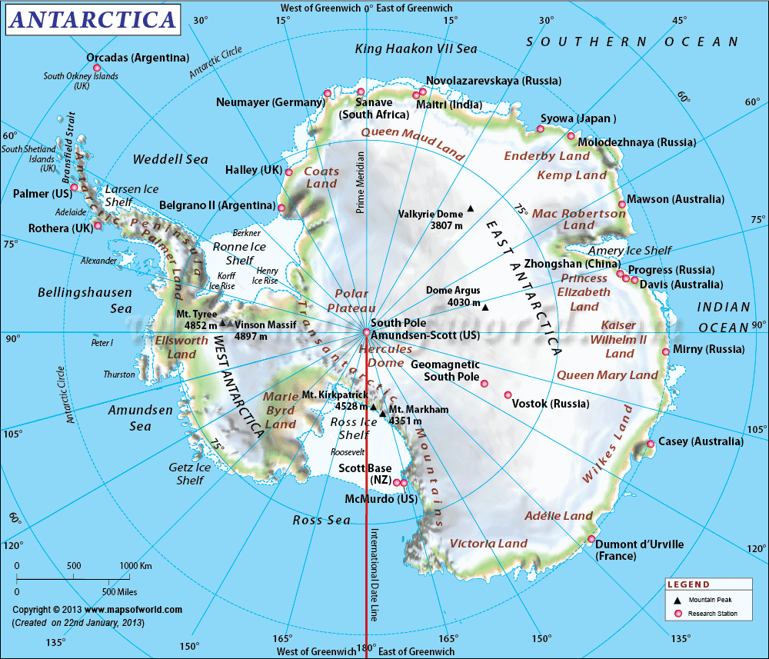
Columbia Climate Center at the Earth Institute * Barnard College * American Museum of Natural History * Arctic Institute of North America * Association of Interior Native Educators * Center for New Media Teaching & Learning * Center for Research on Environmental Decisions * International Arctic Research Center * Lamont-Doherty Earth Observatory * Museum of the North * Teachers College * University of Alaska Fairbanks * University of New Hampshire
http://www.mapsofworld.com/antarctica/maps/antarctica-map.gif

Slide 6
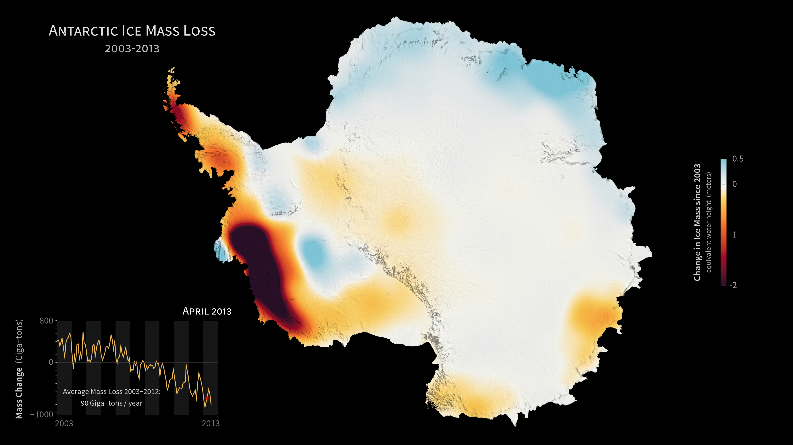
Columbia Climate Center at the Earth Institute * Barnard College * American Museum of Natural History * Arctic Institute of North America * Association of Interior Native Educators * Center for New Media Teaching & Learning * Center for Research on Environmental Decisions * International Arctic Research Center * Lamont-Doherty Earth Observatory * Museum of the North * Teachers College * University of Alaska Fairbanks * University of New Hampshire
GRACE Gravity image by NASA

Slide 7
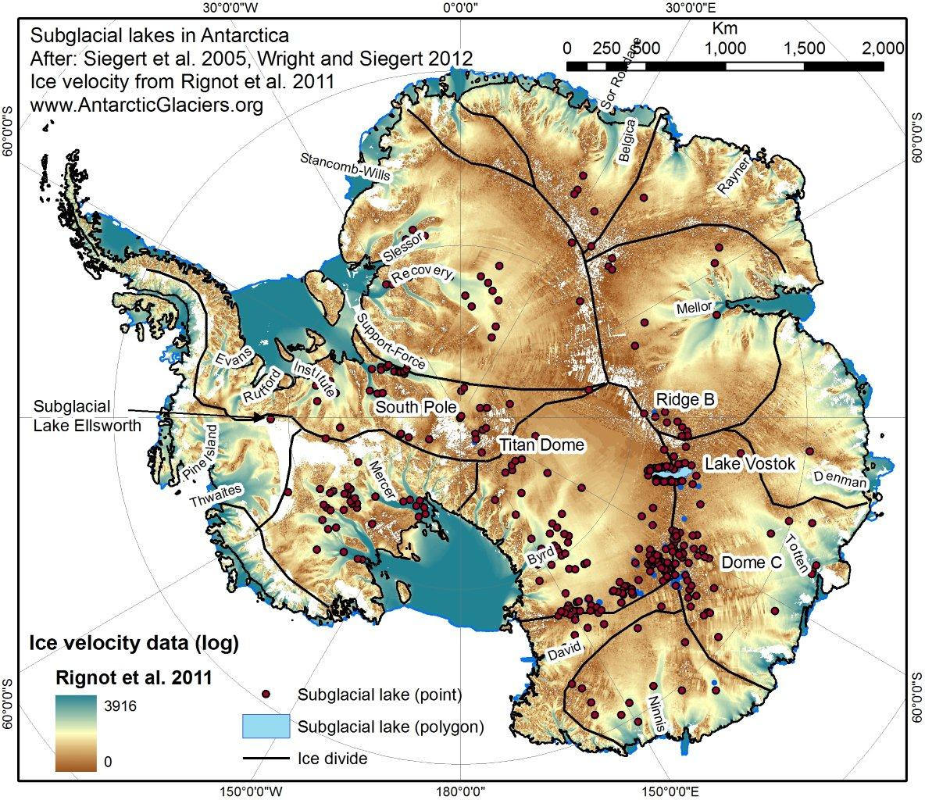
Columbia Climate Center at the Earth Institute * Barnard College * American Museum of Natural History * Arctic Institute of North America * Association of Interior Native Educators * Center for New Media Teaching & Learning * Center for Research on Environmental Decisions * International Arctic Research Center * Lamont-Doherty Earth Observatory * Museum of the North * Teachers College * University of Alaska Fairbanks * University of New Hampshire

Slide 8
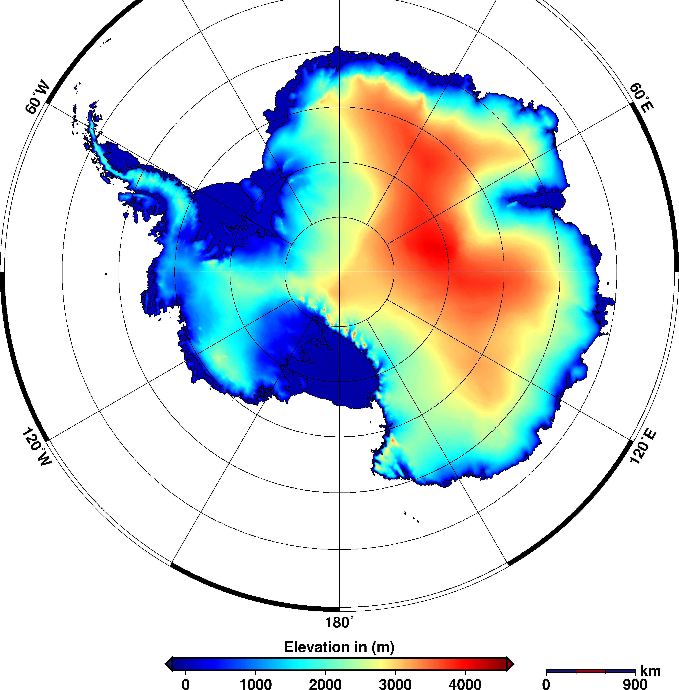
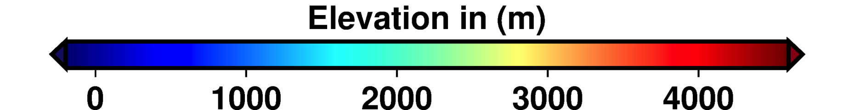
Ice Elevation Map
http://www.esa.int/var/esa/storage/images/esa_multimedia/images/2014/08/antarctic_ice-sheet_height/14726495-1-eng-GB/Antarctic_ice-sheet_height.png
Columbia Climate Center at the Earth Institute * Barnard College * American Museum of Natural History * Arctic Institute of North America * Association of Interior Native Educators * Center for New Media Teaching & Learning * Center for Research on Environmental Decisions * International Arctic Research Center * Lamont-Doherty Earth Observatory * Museum of the North * Teachers College * University of Alaska Fairbanks * University of New Hampshire
Notes:
http://www.esa.int/var/esa/storage/images/esa_multimedia/images/2014/08/antarctic_ice-sheet_height/14726495-1-eng-GB/Antarctic_ice-sheet_height.png

